Slide 1

Learning Management System
School of Computing Science and Engineering
School of computer science and engineering
By :Revant Singh (TL)(Adm No. -23SCSE1011997)
Drishti Khundiyan (Adm No.- 23SCSE1012813)
Bulbul Chaudhary (Adm No. -23SCSE1012810)
Team No-17
(Virtual Scholars)
B.Tech CSE Sec-1 (Sem-3)
GALGOTIAS UNIVERSITY

Slide 2
Index
School of Computing Science and Engineering
Introduction
Problem Statement
Objective
Roadmap
Technical Stuff
Application
Faculty Name: Dr. Santosh Kumar Srivastava ame:

Slide 3
Introduction
School of Computing Science and Engineering
A Learning Management System (LMS) is a software application or web-based technology designed to plan, implement, and assess a specific learning process. It provides a platform for the administration, documentation, tracking, reporting, and delivery of educational courses or training programs.
LMS is commonly used in:
Educational Institutions: To facilitate e-learning, blending traditional methods with online resources.
Corporate Settings: For employee training and professional development.
Key Features of LMS:
Centralized Learning: Allows users to access learning materials from one location.
Personalization: Customizes learning paths based on individual needs.
Tracking and Reporting: Provides detailed analytics on learner progress and performance.
Collaboration: Encourages interaction through discussion forums, messaging, and group projects.
In this presentation, we will explore:
The importance of LMS in modern education and training.
Faculty Name: Dr. Santosh Kumar Srivastava ame:

Slide 4
Problem Statement
School of Computing Science and Engineering
In today’s fast-evolving digital landscape, traditional learning methods are often unable to meet the needs of modern learners and organizations. Some key challenges include:
Geographical Barriers: Physical classrooms and in-person training limit access to education and professional development for remote learners and employees.
Limited Flexibility: Learners often struggle to balance education or training with work and personal commitments due to rigid schedules.
Inconsistent Learning Experiences: Lack of standardization in content delivery can lead to gaps in knowledge retention and skill acquisition.
Faculty Name: Dr. Santosh Kumar Srivastava ame:

Slide 5
Objective
School of Computing Science and Engineering
The primary objective of this presentation is to explore how Learning Management Systems (LMS) address the challenges faced by traditional learning and training methods. Specifically, we aim to:
Understand LMS Fundamentals:
Define what an LMS is and explain its key components.
Highlight the different types of LMS used in education and corporate training.
Examine LMS Functionality:
Investigate core LMS features such as course management, tracking, reporting, and assessment tools.
Understand how LMS fosters collaboration through discussion forums, group projects, and real-time communication.
Evaluate LMS Impact on Education and Training:
Discuss how LMS enhances the learning experience in educational institutions and corporate environments.
Measure the effectiveness of LMS in improving learner performance and retention.
Faculty Name: Dr. Santosh Kumar Srivastava ame:

Slide 6
Flow Diagram
School of Computing Science and Engineering
User registration
Course
Creation
Content
Delivery
Assessment &Testing
Data Analysis
Feedback Collection
Progress Tracking
Faculty Name: Dr. Santosh Kumar Srivastava ame:

Slide 7
Technical Stacks
School of Computing Science and Engineering
Backend:
Java: Commonly used in enterprise-level LMS platforms due to its robustness, security, and scalability.
MySQL : A common open-source relational database used by LMS platforms like Moodle for managing user data, course content, and reports.
Frontend:
JavaScript: Used for both front-end and back-end development
Version Control:
Git and GitHub :Used for version control and collaborative development in LMS projects
Faculty Name: Dr. Santosh Kumar Srivastava ame:

Slide 8
Applications
School of Computing Science and Engineering
Educational Institutions
Higher Education: Universities and colleges use LMS to deliver online courses, manage virtual classrooms, and provide students with access to extensive learning resources.
Non-Formal Education
Personal Development: LMS platforms enable users to access self-paced learning on a variety of subjects such as photography, cooking, fitness, language learning, and more. Platforms like Udemy, Skillshare, and LinkedIn Learning offer thousands of courses for individual learners.
Faculty Name: Dr. Santosh Kumar Srivastava ame:

Slide 9
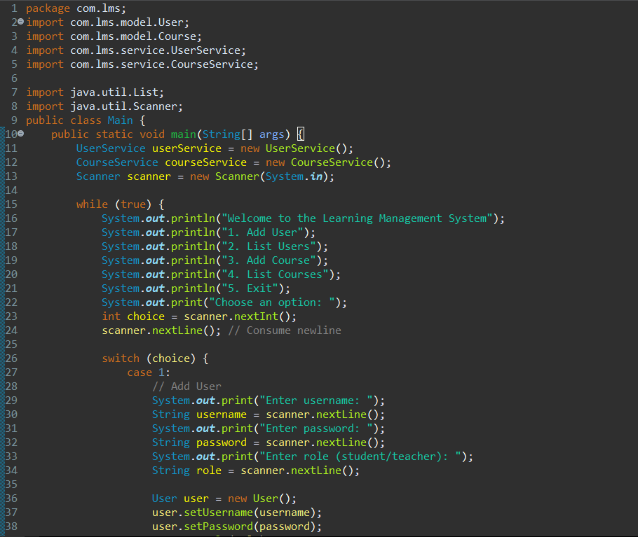
Main Class Code Snippet
Faculty Name: Dr. Santosh Kumar Srivastava ame:

Slide 10
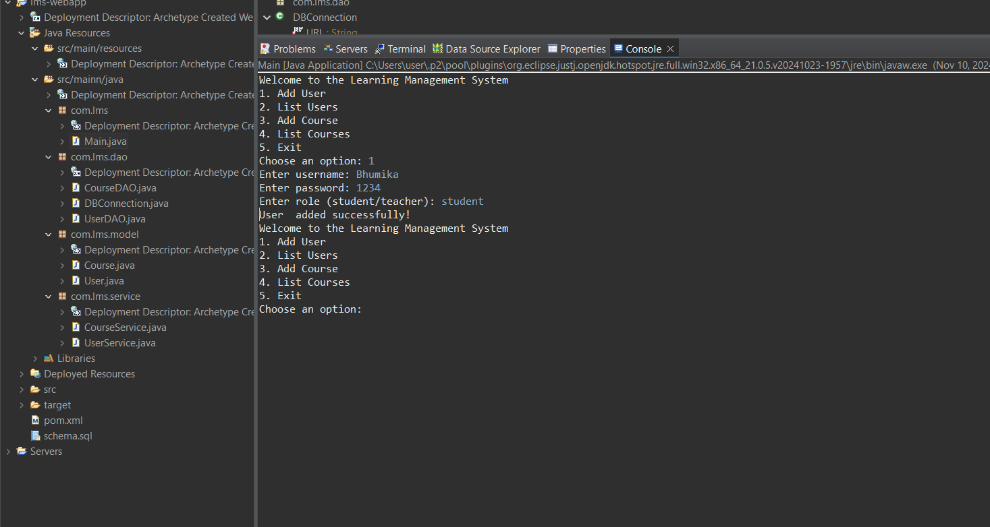
Output Screenshot
Faculty Name: Dr. Santosh Kumar Srivastava ame:

